Slide 1
MACHINE LEARNING
Section 3
Convolutional Neural Networks:
Deep Learning with Images

Slide 2
Contact Information
Instructor: Qi Hao
E-mail: hao.q@sustc.edu.cn
Office: Nanshan iPark A7 Room 906
Office Hours: M 2:00-4:00pm
Available other times by appointment or the open door policy
Office Phone: (0755) 8801-8537
QQ: 463715202 机器学习2018
Web: http://hqlab.sustc.science/teaching/

Slide 3
Some cool projects

Slide 4
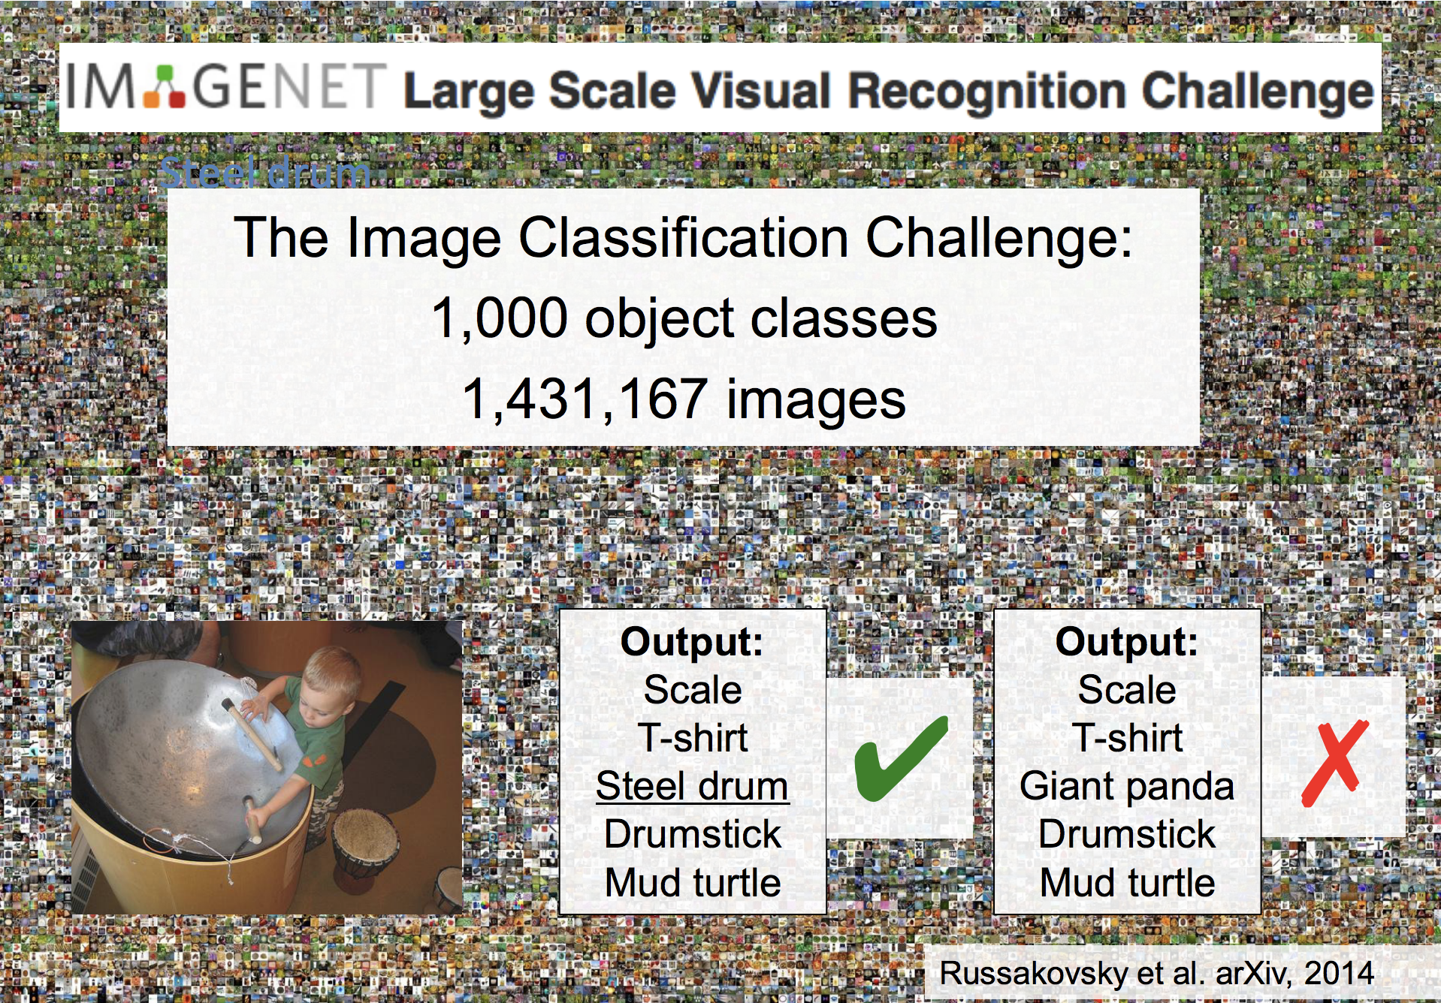

Slide 5
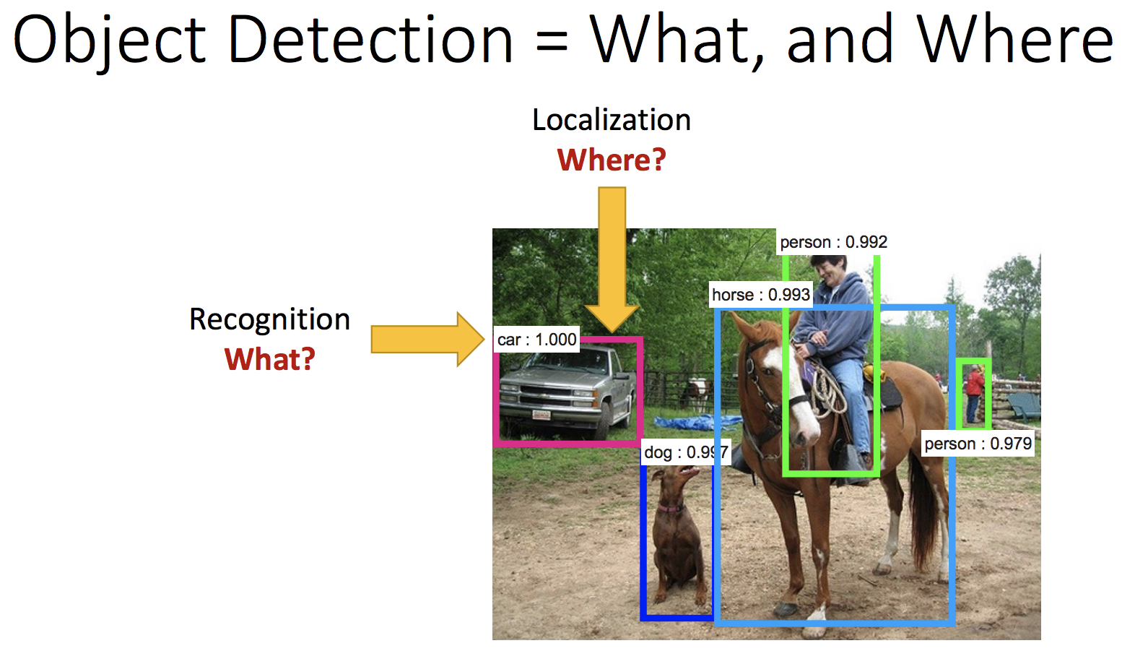

Slide 6
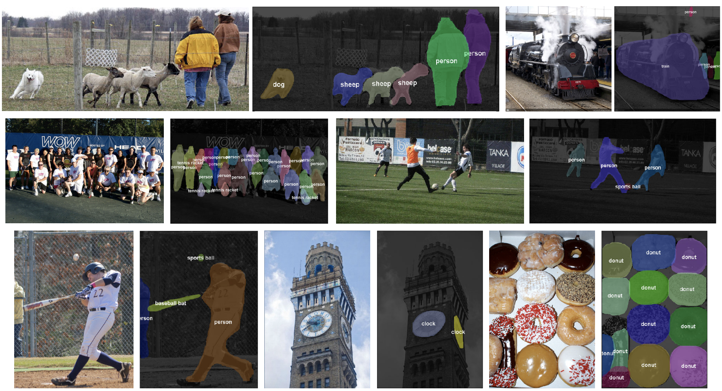
Object Segmentation
Figure credit: Dai, He, and Sun, “Instance-aware Semantic Segmentation via Multi-task Network Cascades”, CVPR 2016

Slide 7
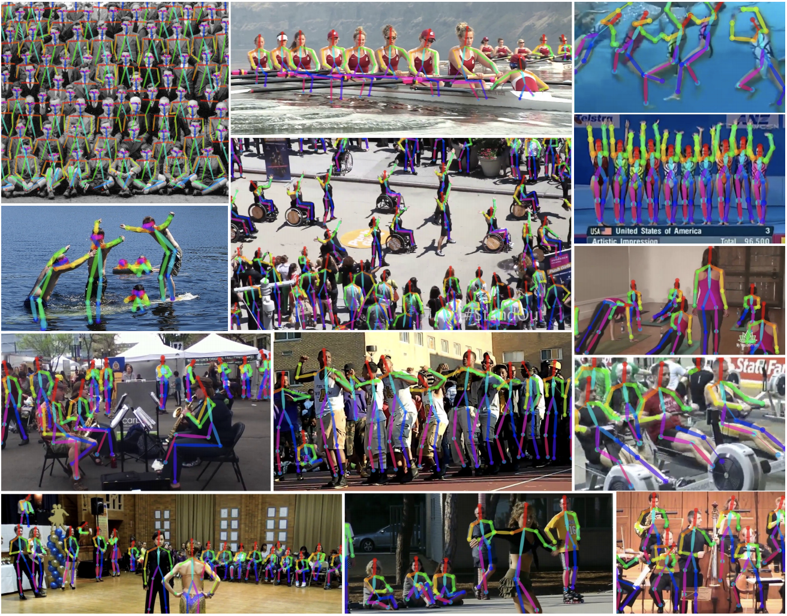
Pose Estimation
Figure credit: Cao et al, “Realtime Multi-Person 2D Pose Estimation using Part Affinity Fields”, arXiv 2016

Slide 8
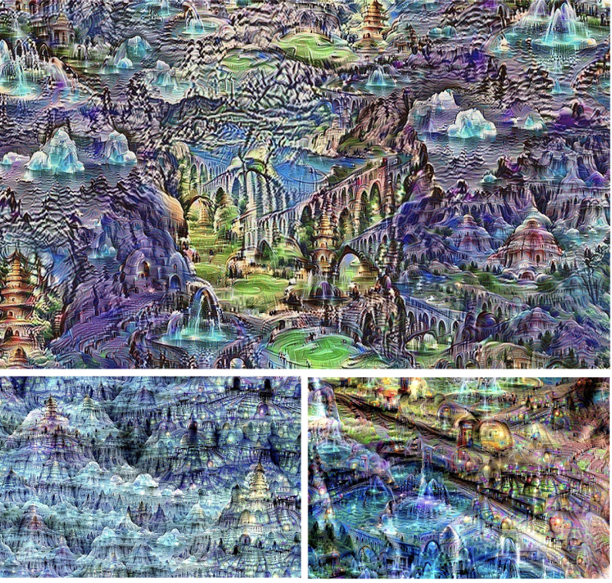
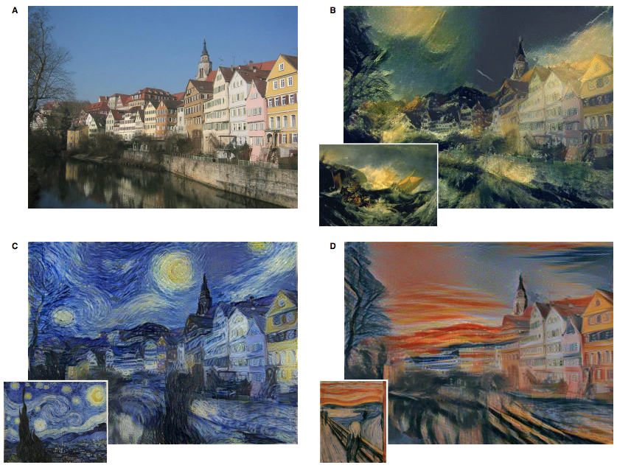
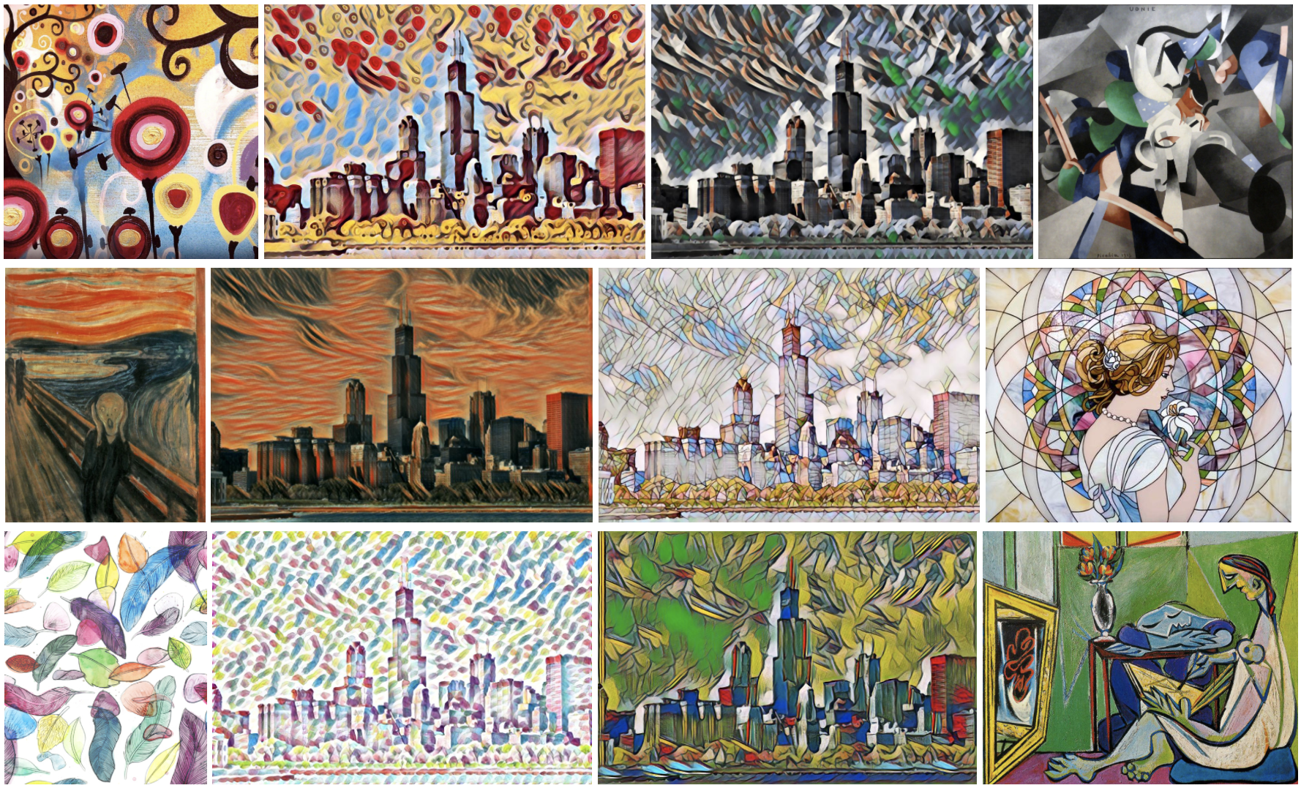
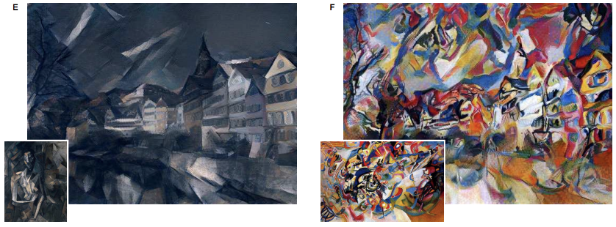
Art generation
Gatys, Ecker, and Bethge, “Image Style Transfer using Convolutional Neural Networks”, CVPR 2016 (left)
Mordvintsev, Olah, and Tyka, “Inceptionism: Going Deeper into Neural Networks” (upper right)
Johnson, Alahi, and Fei-Fei: “Perceptual Losses for Real-Time Style Transfer and Super-Resolution”, ECCV 2016 (bottom left)

Slide 9
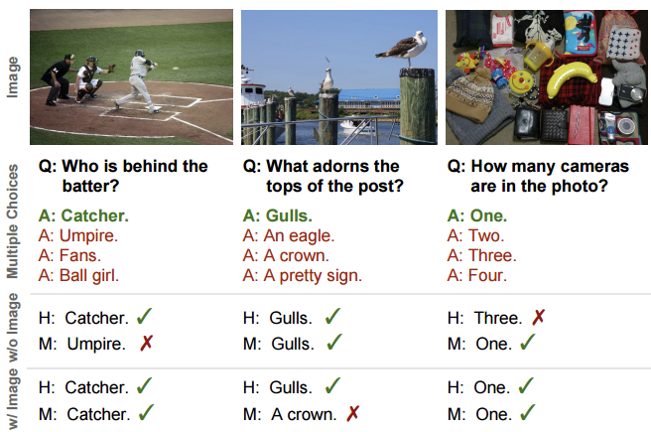
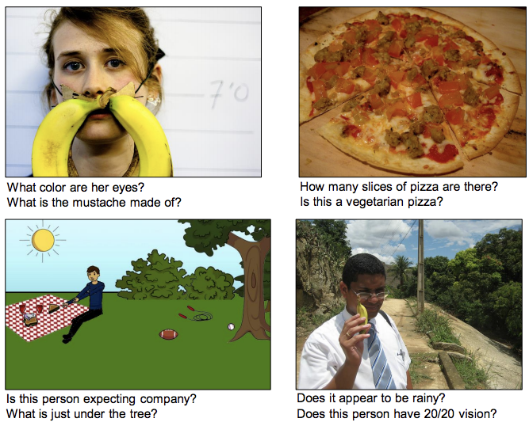
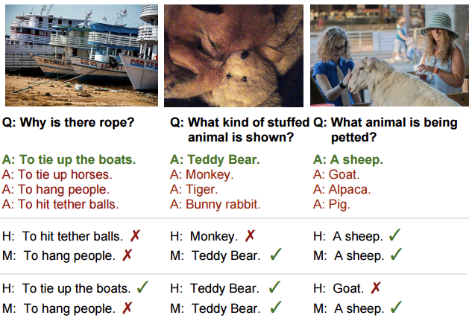
Visual Question Answering
Figure credit: Agrawal et al, “VQA: Visual Question Answering”, ICCV 2015 (left)
Zhu et al, “Visual7W: Grounded Question Answering in Images”, CVPR 2016 (right)
(r

Slide 10
hope that this class will give you the tool to build cool projects like those!

Slide 11
What are connectionist neural networks?
Connectionism refers to a computer modeling approach to computation that is loosely based upon the architecture of the brain.
Many different models, but all include:
Multiple, individual “nodes” or “units” that operate at the same time (in parallel)
A network that connects the nodes together
Information is stored in a distributed fashion among the links that connect the nodes
Learning can occur with gradual changes in connection strength

Slide 12
Many of you are ahead of me in academia so I probably need more of your help than you do mine

Slide 13
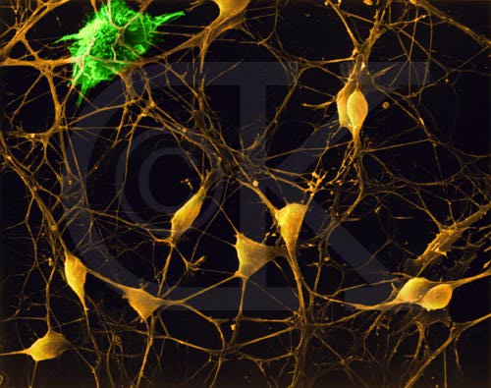
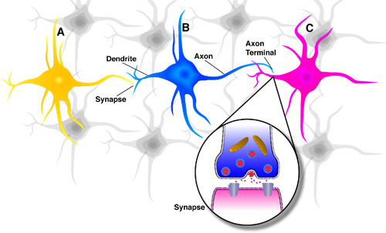
Neurons in the Brain
Although heterogeneous, at a low level the brain is composed of neurons
A neuron receives input from other neurons (generally thousands) from its synapses
Inputs are approximately summed
When the input exceeds a threshold the neuron sends an electrical spike that travels that travels from the body, down the axon, to the next neuron(s)

Slide 14
The Neuron
The neuron is the basic information processing unit of a NN. It consists of:
A set of synapses or connecting links, each link characterized by a weight: W₁, W₂, …, W_{m}
An adder function (linear combiner) which computes the weighted sum of the inputs:
Activation function (squashing function) for limiting the amplitude of the output of the neuron.

Slide 15
The Neuron
Bias
b
x₁
w₁
Activation
function
Local
Field
v
Output
y
Input
signal
x₂
w₂
Summing
function
x_{m}
w_{m}
Learning Procedure:
Randomly assign weights (between 0-1)
Present inputs from training data
Get output O, nudge weights to gives results toward our desired output T
Repeat; stop when no errors, or enough epochs completed
Synaptic
weights

Slide 16
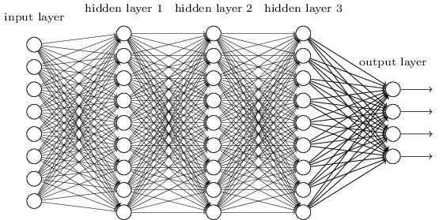
So, 1. what exactly is deep learning ?
And, 2. why is it generally better than other methods on image, speech and certain other types of data?
The short answers
1. ‘Deep Learning’ means using a neural network
with several layers of nodes between input and output
2. the series of layers between input & output do
feature identification and processing in a series of stages, just as our brains seem to.

Slide 17
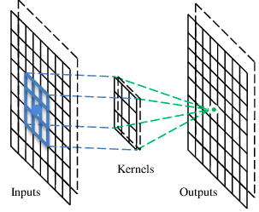
A convolutional layer
A CNN is a neural network with some convolutional layers
(and some other layers). A convolutional layer has a number
of filters that does convolutional operation.
Beak detector
A filter

Slide 18


Consider learning an image:
Some patterns are much smaller than the whole image
Can represent a small region with fewer parameters
“beak” detector

Slide 19

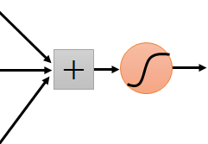
Same pattern appears in different places: They can be compressed! What about training a lot of such “small” detectors and each detector must “move around”.
“upper-left beak” detector
They can be compressed
to the same parameters.
“middle beak” detector

Slide 20
Convolution
These are the network parameters to be learned.
1 | -1 | -1
-1 | 1 | -1
-1 | -1 | 1
1 | 0 | 0 | 0 | 0 | 1
0 | 1 | 0 | 0 | 1 | 0
0 | 0 | 1 | 1 | 0 | 0
1 | 0 | 0 | 0 | 1 | 0
0 | 1 | 0 | 0 | 1 | 0
0 | 0 | 1 | 0 | 1 | 0
Filter 1
-1 | 1 | -1
-1 | 1 | -1
-1 | 1 | -1
Filter 2
……
6 x 6 image
Each filter detects a small pattern (3 x 3).

Slide 21
Convolution
1 | -1 | -1
-1 | 1 | -1
-1 | -1 | 1
Filter 1
stride=1
1 | 0 | 0 | 0 | 0 | 1
0 | 1 | 0 | 0 | 1 | 0
0 | 0 | 1 | 1 | 0 | 0
1 | 0 | 0 | 0 | 1 | 0
0 | 1 | 0 | 0 | 1 | 0
0 | 0 | 1 | 0 | 1 | 0
Dot
product
3
-1
6 x 6 image

Slide 22
Convolution
1 | -1 | -1
-1 | 1 | -1
-1 | -1 | 1
Filter 1
If stride=2
1 | 0 | 0 | 0 | 0 | 1
0 | 1 | 0 | 0 | 1 | 0
0 | 0 | 1 | 1 | 0 | 0
1 | 0 | 0 | 0 | 1 | 0
0 | 1 | 0 | 0 | 1 | 0
0 | 0 | 1 | 0 | 1 | 0
3
-3
6 x 6 image

Slide 23
Convolution
1 | -1 | -1
-1 | 1 | -1
-1 | -1 | 1
Filter 1
stride=1
1 | 0 | 0 | 0 | 0 | 1
0 | 1 | 0 | 0 | 1 | 0
0 | 0 | 1 | 1 | 0 | 0
1 | 0 | 0 | 0 | 1 | 0
0 | 1 | 0 | 0 | 1 | 0
0 | 0 | 1 | 0 | 1 | 0
3
-1
-3
-1
-3
1
0
-3
-3
-3
0
1
3
-2
-2
-1
6 x 6 image

Slide 24
Convolution
-1 | 1 | -1
-1 | 1 | -1
-1 | 1 | -1
Filter 2
stride=1
Repeat this for each filter
1 | 0 | 0 | 0 | 0 | 1
0 | 1 | 0 | 0 | 1 | 0
0 | 0 | 1 | 1 | 0 | 0
1 | 0 | 0 | 0 | 1 | 0
0 | 1 | 0 | 0 | 1 | 0
0 | 0 | 1 | 0 | 1 | 0
3
-1
-3
-1
-1
-1
-1
-1
-3
1
0
-3
-1
-1
-2
1
Feature
Map
-3
-3
0
1
-1
-1
-2
1
3
-2
-2
-1
6 x 6 image
-1
0
-4
3
Two 4 x 4 images
Forming 2 x 4 x 4 matrix

Slide 25
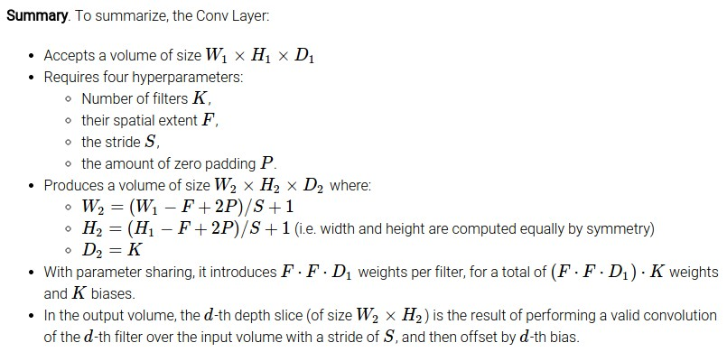
Common settings:
K = (powers of 2, e.g. 32, 64, 128, 512)
F = 3, S = 1, P = 1
F = 5, S = 1, P = 2
F = 5, S = 2, P = ? (whatever fits)
F = 1, S = 1, P = 0

Slide 26
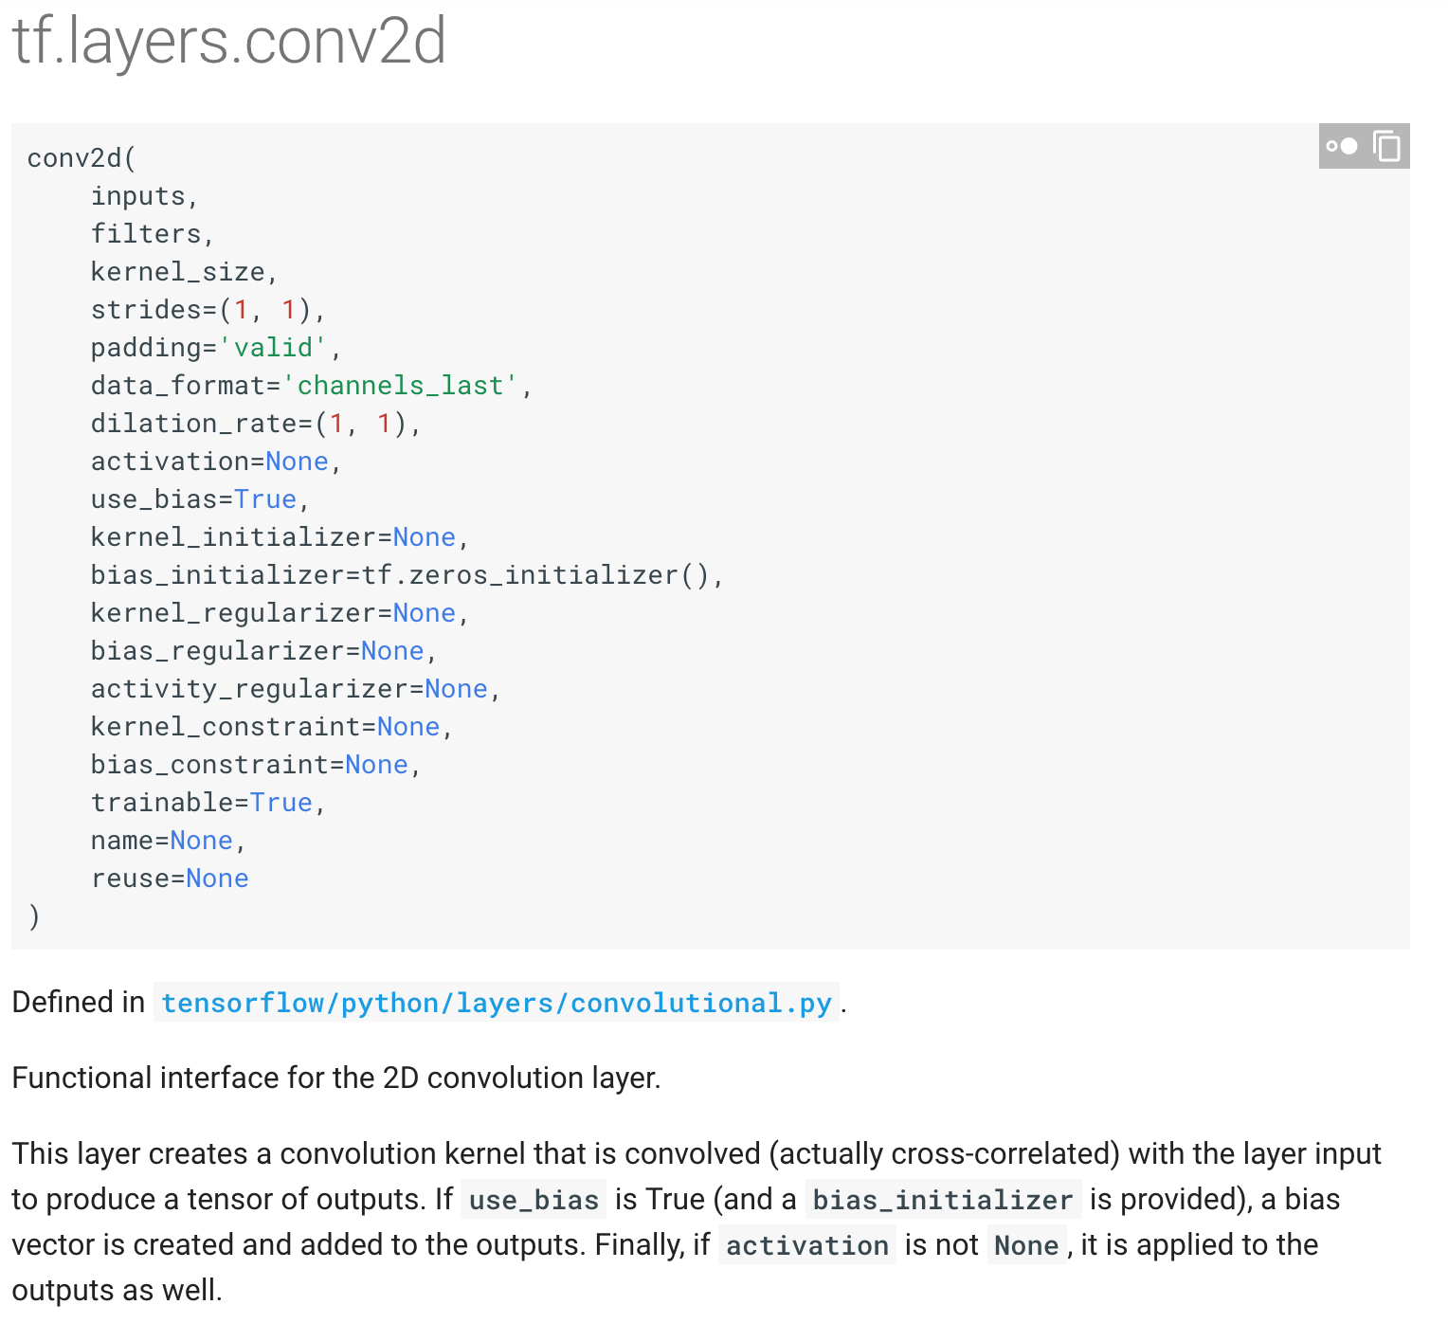
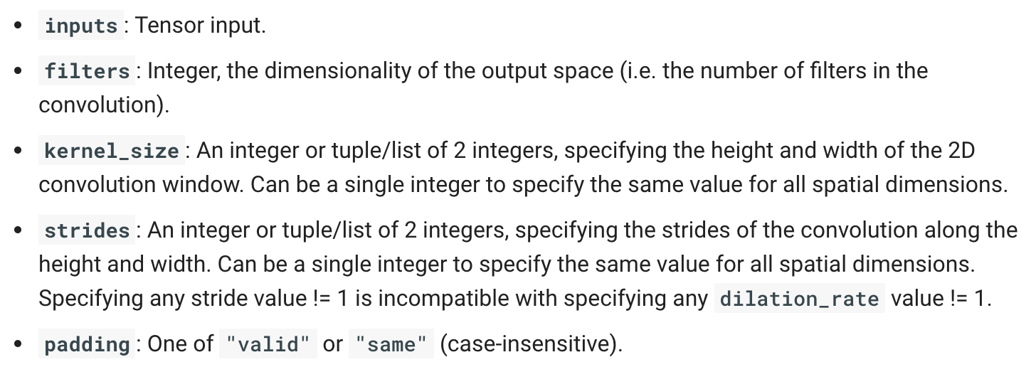

Slide 27
Convolution layer in tensorflow
We will be using tf.nn.conv2d for the convolutional layer. A common practice is to group convolutional layer and non-linearity together, which we will do in this case. We will create a method conv_relu that can be used for both convolutional layers.
def conv_relu(inputs, filters, k_size, stride, padding, scope_name): with tf.variable_scope(scope_name, reuse=tf.AUTO_REUSE) as scope: in_channels = inputs.shape[-1] kernel = tf.get_variable('kernel', [k_size, k_size, in_channels, filters], initializer=tf.truncated_normal_initializer()) biases = tf.get_variable('biases', [filters], initializer=tf.random_normal_initializer()) conv = tf.nn.conv2d(inputs, kernel, strides=[1, stride, stride, 1], padding=padding) return tf.nn.relu(conv + biases, name=scope.name)

Slide 28


The whole CNN
cat dog ……
Convolution
Max Pooling
Can repeat many times
Fully Connected Feedforward network
Convolution
Max Pooling
Flattened

Slide 29
Max Pooling
1 | -1 | -1
-1 | 1 | -1
-1 | -1 | 1
-1 | 1 | -1
-1 | 1 | -1
-1 | 1 | -1
Filter 1
Filter 2
3
-1
-3
-1
-1
-1
-1
-1
3
0
-1
1
-3
1
0
-3
-1
-1
-2
1
3
1
0
3
-3
-3
0
1
-1
-1
-2
1
3
-2
-2
-1
-1
0
-4
3

Slide 30


Why Pooling
Subsampling pixels will not change the object
bird
bird
Subsampling
We can subsample the pixels to make image smaller
fewer parameters to characterize the image

Slide 31
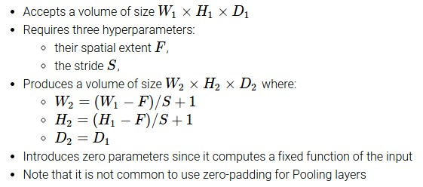
Max Pooling
Common settings:
F = 2, S = 2
F = 3, S = 2

Slide 32
pooling layer in tensorflow
We will be using tf.nn.max_pool for the max pooling layer. We will create a method maxpool that can be used for both convolutional layers.
def maxpool(inputs, ksize, stride, padding='VALID', scope_name='pool'): with tf.variable_scope(scope_name, reuse=tf.AUTO_REUSE) as scope: pool = tf.nn.max_pool(inputs, ksize=[1, ksize, ksize, 1], strides=[1, stride, stride, 1], padding=padding) return pool

Slide 33
The whole CNN
3
0
-1
1
Convolution
3
1
0
3
Max Pooling
Can repeat many times
A new image
Convolution
Smaller than the original image
The number of channels is the number of filters
Max Pooling

Slide 34
Flattening
3
0
1
3
0
-1
1
3
3
1
-1
0
3
Flattened
1
Fully Connected Feedforward network
0
3

Slide 35
Fully connected in tensorflow
We should be pretty familiar with the fully connected layer by now, as we have been using it for all of our models. Fully connected, or dense, layer is called so because every node in the layer is connected to every node in the preceding layer. Convolutional layers are only locally connected.
def fully_connected(inputs, out_dim, scope_name='fc'): with tf.variable_scope(scope_name, reuse=tf.AUTO_REUSE) as scope: in_dim = inputs.shape[-1] w = tf.get_variable('weights', [in_dim, out_dim], initializer=tf.truncated_normal_initializer()) b = tf.get_variable('biases', [out_dim], initializer=tf.constant_initializer(0.0)) out = tf.matmul(inputs, w) + b return out

Slide 36
With those building blocks (layers), we can easily construct our model.
def inference(self): conv1 = conv_relu(inputs=self.img, filters=32, k_size=5, stride=1, padding='SAME', scope_name='conv1') pool1 = maxpool(conv1, 2, 2, 'VALID', 'pool1') conv2 = conv_relu(inputs=pool1, filters=64, k_size=5, stride=1, padding='SAME', scope_name='conv2') pool2 = maxpool(conv2, 2, 2, 'VALID', 'pool2') feature_dim = pool2.shape[1] * pool2.shape[2] * pool2.shape[3] pool2 = tf.reshape(pool2, [-1, feature_dim]) fc = tf.nn.relu(fully_connected(pool2, 1024, 'fc')) dropout = tf.layers.dropout(fc, self.keep_prob, training=self.training, name='dropout') self.logits = fully_connected(dropout, self.n_classes, 'logits')
During training, we alternate between training an epoch and evaluating the accuracy on the test set. We will track both the training loss and test accuracy on Tensorboard.
def eval(self): ''' Count the number of right predictions in a batch ''' with tf.name_scope('predict'): preds = tf.nn.softmax(self.logits) correct_preds = tf.equal(tf.argmax(preds, 1), tf.argmax(self.label, 1)) self.accuracy = tf.reduce_sum(tf.cast(correct_preds, tf.float32))

